Slide 1
266 Natural Language Processing
Week 3 Live Session: Language and Context

Slide 2
This Week
Goals
Understand how sequence and context can affect approaches to processing language
Understand how different neural architectures can be leveraged to understand language

Slide 3
Peeking Ahead
Week 1: Introduction
Week 2: Text Classification
Week 3: Language and Context
Week 4: Pretrained Transformers
Week 5: Text Generation Models
Week 6: Machine Translation PROJECT PROPOSAL DUE FEB 18
Week 7: Question Answering & Summarization
Week 8: Linguistic Representation
Week 9: Entities and Linking
Week 10: Embedding-based Retrieval
Week 11: Multimodality in NLP
Week 12: ML Fairness and Privacy
Week 13: NLP in the Real World

Slide 4
Announcements
Assignment 1 (NN) released last Friday 01/19
Due Sunday, 01/28 (Tuesday 01/30 if you use late days)
Assignment 2 (Classification) - released Friday 01/26
Two weeks to complete
Due Sunday, 02/11 (Tuesday 02/13 if you use late days)
Project Proposals - Due Saturday 02/18!
Will discuss this week
Questions?
Concerns?

Slide 5
Announcements
Paper reading sessions:
How to read a paper and A Sensitivity Analysis of (and Practitioners' Guide to) Convolutional Neural Nets for Sentence Classification
Mark: Tuesday 01/23 5:30 pm PST
oLMpics-On What Language Model Pre-training Captures
Mark: Tuesday 01/30 5:30 pm PST
Notebook Walkthroughs:
TBD
Concerns?

Slide 6
The Plan
Structure of Class
Project Discussion
Review of Last Week’s Material
Language & Context - Theory & Notebooks:
RNNs
Attention
Outlook: Self-Attention

Slide 7
Project Discussion
Language & Context

Slide 8
Final Project
This is all on the course GitHub!
-> Final Project Guidelines <-
Open-ended final project - your chance to explore & apply NLP!
Some project types:
Apply existing NLP algorithm(s) to a new dataset
Develop a new NLP algorithm or technique
Adapt techniques from a recent paper to a new domain
Use NLP algorithms to find patterns or trends in data
One key requirement: language must be the main part of your project.
Notes:
Applied projects more common, but you’re encouraged to explore more abstract or fundamental computational linguistics tasks! (these tend to be fun projects)
All projects will require reading the literature for background, related work, and importantly, ideas.

Slide 9
Project Grading Rubric
Overall themes (10%): | A clear statement of the problem you are trying to solve. Novelty of your approach to the problem.
Crisp objective (20%): | "How will I know when my project is successful?", usually in the form of an evaluation metric Why is this the right objective? Statement of a clear baseline
Methodology and analysis (50%): | Are you using appropriate techniques for the problem you're trying to solve? How did you take what you learned and use that to improve subsequent iterations?
Technical communication (20%): | Is your paper well organized? Succinct, interesting presentation explaining the above
Please read this: Class Syllabus Project Rubric Section - selections

Slide 10
Final Project: Timeline
Project proposal (Feb 18)
Write-up Milestone (Optional - Mar 18)
Project write up (due Apr 14 - HARD DEADLINE)
Final presentations (in-class Apr 15 - 19)
In total, 55% of course grade! Important to start early.

Slide 11
Finding Ideas and Datasets
Best source: read papers! See what people have tried, what data they used.
The Association of Computational Linguistics (ACL) Anthology
ACL, NAACL, EMNLP, NeurIPS, ICML, SigKDD, WSDM
Google Scholar and the arXiv (quality may vary)
More here: Project Proposal Guidelines
Stanford posts open lists of class projects:
cs224n (2000-2017, 2021, 2022, 2023), cs224d (2015, 2016, 2017)

Slide 12
Types of Problems/Tasks
NLP ≈ (machine learning) + (linguistics) + (all sorts of algorithms) + (data)
Text classification / regression
Textual similarity
Sequence labeling
Information retrieval / information extraction
Question answering
Semantics, natural language inference
Summarization
Machine translation
Dialog
Notes:
Color coded by difficulty. Intuition and domain understanding are very important! Pick a problem that you find exciting. Don’t be afraid to skip ahead in the course readings & async to learn more about a topic of interest.
Semantics, NLI, and dialog aren’t covered in this course - but we’re happy to talk about them!

Slide 13
Tasks -> problem structures -> Architectures*
Task | Standard Problem Structure | Architectures
Question Answering | Span Detection | Transformers, Sequence labeling
Machine translation | Sequence to sequence | Transformers, Encoder - decoder
Abstractive Summarization | Sequence to sequence | Transformers, Encoder - decoder
Natural Language Inference (NLI) | Text Pair Classification | Various
Sentiment | Classification | Transformers, CNN
Semantic Role Labeling (SRL) | Sequence Labeling | LSTM, Transformers
Relation Extraction | Classification | various
Goal Directed Dialog | Sequence to sequence | Encoder - decoder
*No claim of completeness is made

Slide 14
Three labelled datasets to consider
If you don’t have a topic in mind, here are three labelled data sets from which you can choose:
Story Ending Classification – ROC Stories
Question Answering – SQUAD 2.0
Supervised Relation Extraction – TACRED

Slide 15
Finding Data
Data is usually the limiting factor in NLP problems (as with most ML)
Most tasks in the async have lots of data available
Interested in a new domain? Be sure you can get data!
Potential data types / sources:
Labeled corpora (Penn Treebank, sentiment data, much, much more)*
Large corpora (Gigaword, Wikipedia, Common Crawl, Google Web 1T)
News articles (NYT, WSJ, Reuters, etc.)
Social media (reddit, Twitter, etc.)
https://datasetsearch.research.google.com/
You may NOT use your company’s proprietary data. Your dataset MUST be viewable by the instructors without an NDA.
Notes:
Lots of text that has some structure associated with is, which often lends itself to rich machine learning tasks. For example: summarization data is (historically) often derived from news headlines, paired with the articles. Or reddit, which has upvotes and comment thread structure.

Slide 16
Getting Data
Have access to many paywalled corpora through UC Berkeley
Linguistic Data Consortium corpora:
Recent corpora in UC Library Search: LDC Ontonotes5 data set
Lookup the LDC catalog number (LDC2013T19 for OntoNotes)
Berkeley Language Center: Collections and Archives

Slide 17
Common pitfalls
If you only remember one thing…
Read existing research. (Do not start from scratch!)
Look at your data before you submit your proposal.
(Corollary: if you want to scrape data, start working on that now)
Notes:
Data collection & processing takes more time than you think - don’t leave it to the last minute and find yourself without time to do the fun parts (experiments)!

Slide 18
Previous sample projects
This folder (using your @berkeley.edu login) contains copies of very successful project papers from earlier semesters that the authors agreed to share:
Comparison of Unsupervised Data Augmentation with BERT and XLNet
Evaluating World Knowledge Representation in Language Models
Transformers to the Rescue: Extracting Insight and Understanding from a RoBERTa Model Tuned for Classifying Disaster Information
Propaganda Span Identification
Semantic Similarity and Response Prediction for Programming QandA
Unsupervised Data Augmentation Experimentation
BERTVision - A Parameter-Efficient Approach for Question Answering
DeBERTa Model Fine-tuned for Commonsense Validation and Explanation
StackReQA: Stack Overflow Retrieval Question Answering

Slide 19
Review of Last Week’s Material
Language & Context

Slide 20
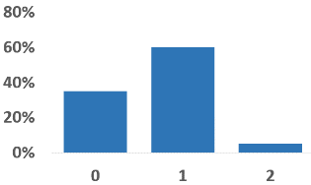
Deep Averaging Networks
Output: Probability distribution over class labels
Questions:
What does this vector represent?
Are all tokens equally important? What else would be nice to have here?
Sigmoid/Softmax
Affine
Nonlinearity
Averaging word vectors element-wise
(“bag of words”)
Affine
‘this’
‘is’
...
‘use’
Input:
“this is of great use”

Slide 21
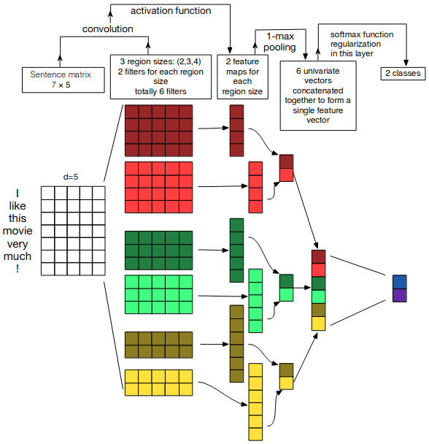
CNNs and Text Classification
Questions
What is the use of word vectors here?
Why are there multiple filters of the same size?
How are the feature maps being calculated? Why do they have different lengths?
Is max pooling here applied in the same way as in the image-inspired scenario?
Would we use pre-trained word vectors or train our own?
Source: Zhang, Wallace, A Sensitivity Analysis of (and Practitioners’ Guide to) Convolutional Neural Networks for Sentence Classification, https://arxiv.org/pdf/1510.03820.pdf

Slide 22
Modeling Context
Language & Context

Slide 23
Why Context
NLP problems where context matters - come up with
Named Entity Recognition [determination of location, organization,..., other] Example: ?
Next-word prediction Example: ?
Spelling correction Example: ?
… context is critical all over! Translation, Question Answering, Information Extraction, …, everywhere!

Slide 24
Why Context
NLP problems where context matters - come up with
Named Entity Recognition [determination of location, organization,..., other] Example: “I bought a computer from apple…”
Next-word prediction Example: ?
Spelling correction Example: ?
… context is critical all over! Translation, Question Answering, Information Extraction, …, everywhere!

Slide 25
Why Context
NLP problems where context matters - come up with
Named Entity Recognition [determination of location, organization,..., other] Example: “I bought a computer from apple…”
Next-word prediction Example: “The sky is …”
Spelling correction Example: ?
… context is critical all over! Translation, Question Answering, Information Extraction, …, everywhere!

Slide 26
Why Context
NLP problems where context matters
Named Entity Recognition [determination of location, organization,..., other] Example: “I bought a computer from apple…”
Next-word prediction Example: “The sky is …”
Spelling correction Example: “The sky person gave a timid speech”
… context is critical all over! Translation, Question Answering, Information Extraction, …, everywhere!

Slide 27
Language Models
\
What are Language Models?
Why are they useful?
How can we model them?

Slide 28
Language Models - An Example
P(“I”, “saw”, “her ”, “again”, “yesterday”) = ?

Slide 29
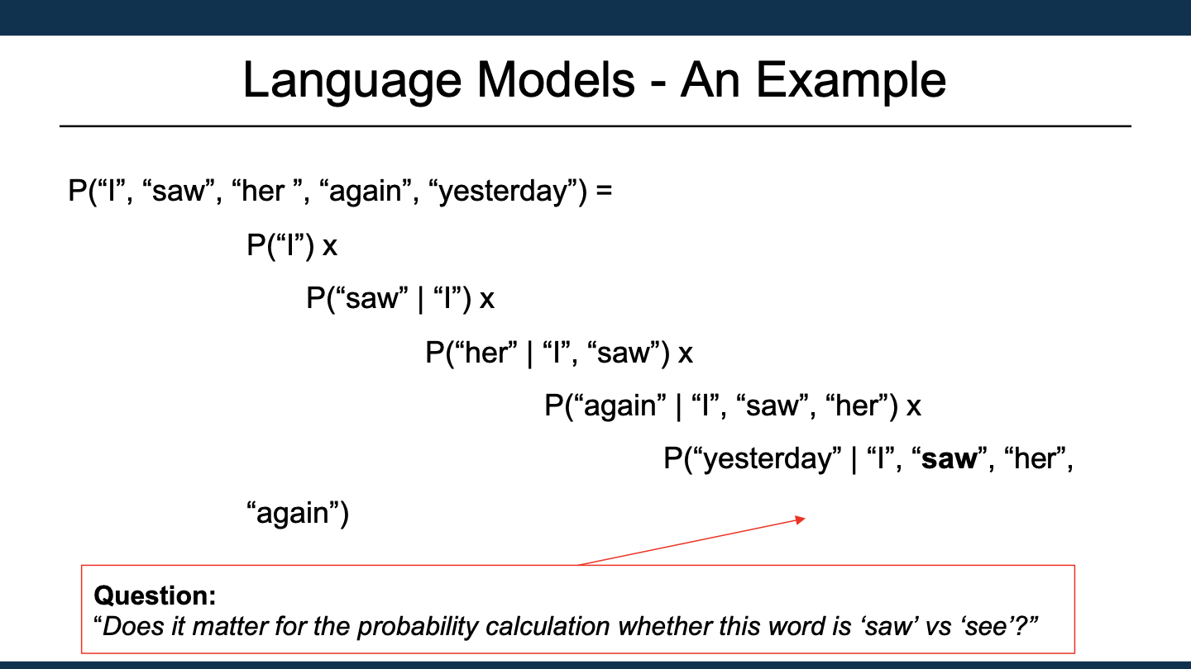
Language Models - An Example
P(“I”, “saw”, “her ”, “again”, “yesterday”) =
P(“I”) x
P(“saw” | “I”) x
P(“her” | “I”, “saw”) x
P(“again” | “I”, “saw”, “her”) x
P(“yesterday” | “I”, “saw”, “her”, “again”)
Question: “Does it matter for the probability calculation whether this word is ‘saw’ vs ‘see’?”

Slide 30
Language Models - Counting
What is going on here in this counting example?
What are the approximations?
How can we improve these models

Slide 31
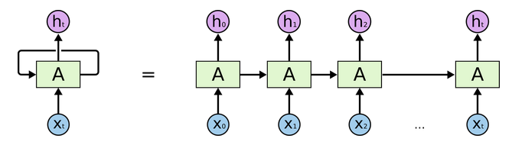
Language Models - RNNs
What is going on here?
What are the h’s?
What are the arrows, what is their purpose?
And what has this to do with Language Models?
P(“again” | “I”, “saw”, “her”)
Image Source for LSTM Structure: Chris Olah, Understanding LSTM Networks, https://colah.github.io/posts/2015-08-Understanding-LSTMs

Slide 32
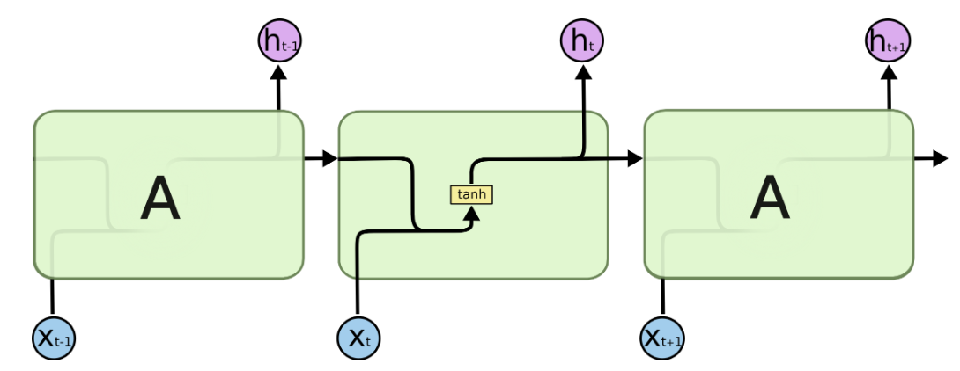
Language Models - RNNs
Simple RNN - What is going on here?
What are the limitations of this simple RNN architecture?
Image Source for LSTM Structure: Chris Olah, Understanding LSTM Networks, https://colah.github.io/posts/2015-08-Understanding-LSTMs

Slide 33
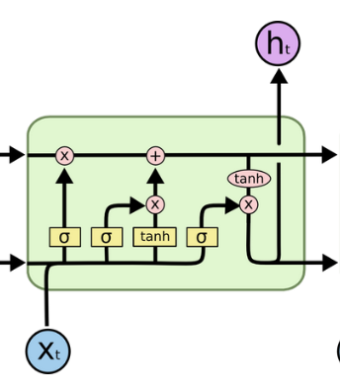
Language Models - LSTMs
LSTM architecture
Questions:
What is happening at each gate?
Why is this architecture better than the simple RNN?
If the dimension of the RNN inputs are d=200, what is the dimension of the weight matrix in the forget gate?
sigmoid([x_{t}; h_{t-1}] W_{f} + b_{f})
Image Source for LSTM Structure: Chris Olah, Understanding LSTM Networks, https://colah.github.io/posts/2015-08-Understanding-LSTMs

Slide 34
Language Models - LSTMs
LSTM architecture
f_{t} = σ (x_{t}W_{xf} + h_{t−1}W_{hf} + b_{f}) | (1)
i_{t} = σ (x_{t}W_{xi} + h_{t−1}W_{hi} + b_{i}) | (2)
c_{t} = f_{t}⋅ c_{t−1} + i_{t}⋅ tanh(x_{t}W_{xc} + h_{t−1}W_{hc} + b_{c} ) | (3)
o_{t} = σ (x_{t}W_{xo} + h_{t−1}W_{ho} + b_{o}) | (4)
h_{t} = o_{t}⋅ tanh(c_{t}) | (5)
sigmoid([x_{t}; h_{t-1}] W_{f} + b_{f})
Image Source for LSTM Structure: Chris Olah, Understanding LSTM Networks, https://colah.github.io/posts/2015-08-Understanding-LSTMs

Slide 35
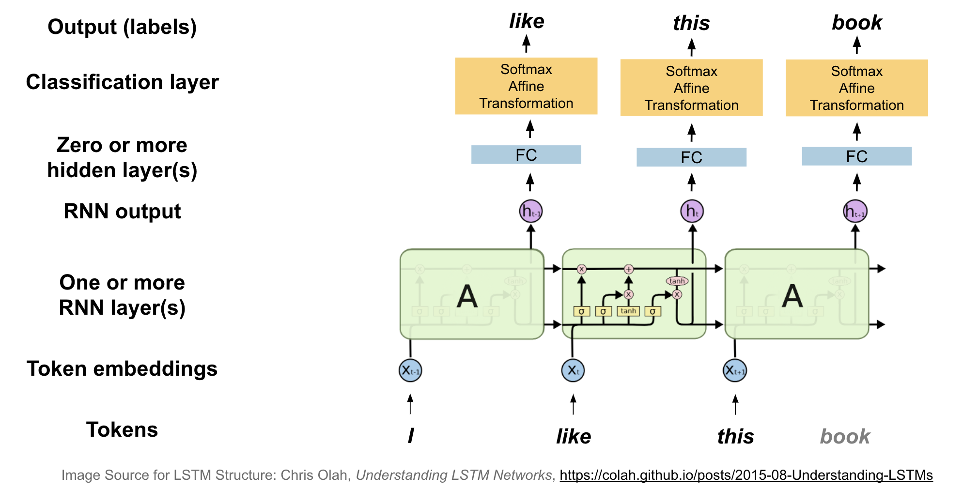
Language Models & LSTMs
How could we use an LSTM/RNN to actually build a Language Model? (Imagine the training example “I like this book”)
?
?

Slide 36
Language Models & LSTMs
Questions:
How do we usually train these models
How is inference done?

Slide 37
Let’s Build This!
Joint Notebook Work

Slide 38
Context & Attention
Context in RNNs
\

Slide 39
Context & Attention
\
But don’t these vectors also contain context?

Slide 40
Context & Attention
\
And also these…

Slide 41
Context & Attention https://distill.pub/2016/augmented-rnns/
In general maybe:
“I need the context of what was said to make some prediction”
k₁
k₂
k₃
k₄
k₅
I like this book very

Slide 42
Context & Attention
In general maybe:
Construct and send a query vector
q
“I need the context of what was said to make some prediction”
k₁
k₂
k₃
k₄
k₅
I like this book very

Slide 43
Context & Attention
In general maybe:
Calculate a weight for the weight of each position 𝛼(q, k_{t})
q
“I need the context of what was said to make some prediction”
k₁
k₂
k₃
k₄
k₅
I like this book very

Slide 44
Context & Attention
In general maybe:
Generate context vector c as weighted average of value vectors v using the 𝛼(q, k_{t})
q
“I need the context of what was said to make some prediction”
k₁
k₂
k₃
k₄
k₅
Note: The value vectors v represent each position for context construction. Often, the k’s are used. But in general, k’s and v’s can be different. (And they can be learned as part of training)
I like this book very

Slide 45
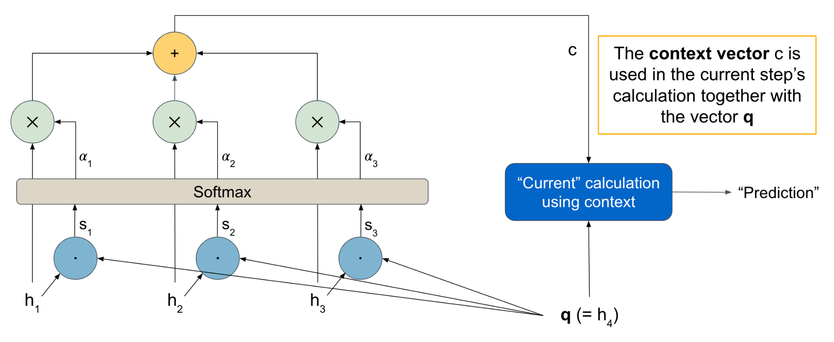
Context & Attention: Dot-Product Attention

Slide 46
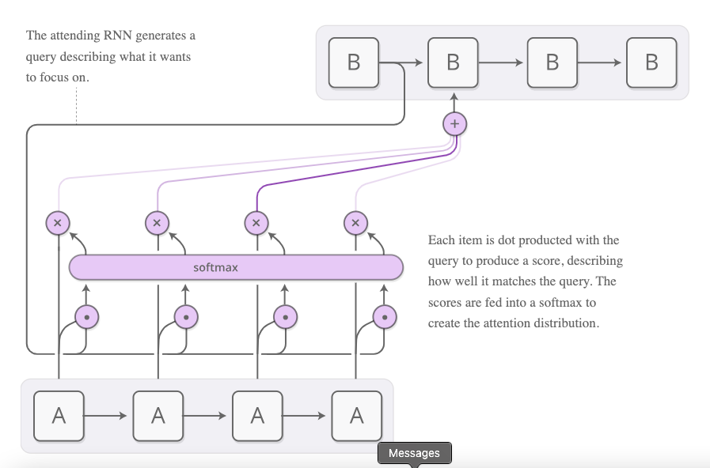
Context & Attention: Dot-Product Attention

Slide 47
Simple Attention
Attention layer
Word embeddings (keys/values)
reuse embeds as values
multiply
this
delightful
movie
got
laughs
1
0
0
0
sum
2
-1
.5
-.3
dot product
0
0
1.9
-1.7
0
3
-1
0
softmax
0
0
2
-2
1
0.03
1.4
-1.4
3
0.26
-3
0.00
use embeds as keys
-1
0.00
4
0.70
attention weights (alphas)
query vector
1
-1
Notes:
Pink = input (4 observations)
H1 = blue (4 hidden states but W and b are same size as they get re-used for each observation)
H2 = yellow (4 hidden states but W and b are same size as they get re-used for each observation)
Output = green (4 predictions)

Slide 48
Context & Attention: Dot-Product Attention
\
Class calculation using standard dot-product attention:
q = [1, 2]
k = v = [[-1, 1], [5, -2]]
k.q, v.q = [1,1]
alpha = Softmax ([1,1]) = [½,½]
alpha_1 * [-1, 1] + alpha_2 * [5, -2] =
[-½, ½] + [2.5, -1] = [2, -.5]

Slide 49
Revisiting Averaging Networks
Output: Probability distribution over class labels
Questions:
With the Attention formalism… could we do this better?
What would we need? (Hidden hint: you’ll do that in your next assignment…)
Sigmoid/Softmax
Affine
Nonlinearity
Averaging word vectors element-wise
(“bag of words”)
Affine
‘this’
‘is’
...
‘use’
Input:
“this is of great use”

Slide 50
Revisiting Averaging Networks
Output: Probability distribution over class labels
How to do it:
“Learn” a query vector q and use attention calculation, with embedding vectors as keys (and values)!
(see upcoming assignment!)
Sigmoid/Softmax
Affine
Nonlinearity
Averaging word vectors element-wise
(“bag of words”)
Affine
q
k₁
k₂
k…
k_{n}
‘this’
‘is’
...
‘use’
Input:
“this is of great use”

Slide 51
Paper Peeks/Recent Advances/Challenges
Language & Context

Slide 52
Extras
Language & Context

Slide 53
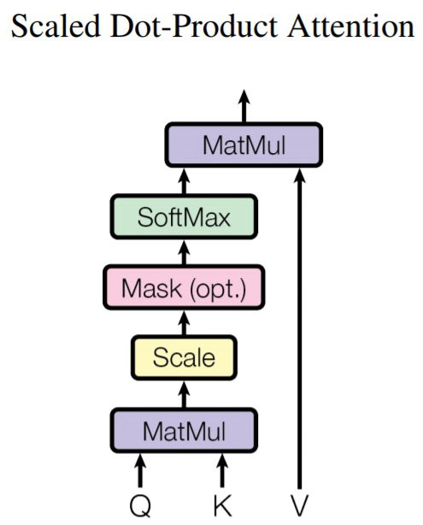
Context & Attention: Dot-Product Attention
Used in Transformers (next week)

Slide 54
What Can We Do Now?
“Hmmm…
I am sending in a sequence of word embeddings…
from the LSTM I get a sequence of vectors mapped 1:1
to input words...
Could I maybe interpret these output vectors (with a bit more work) as context-dependent word embeddings?”

Slide 55
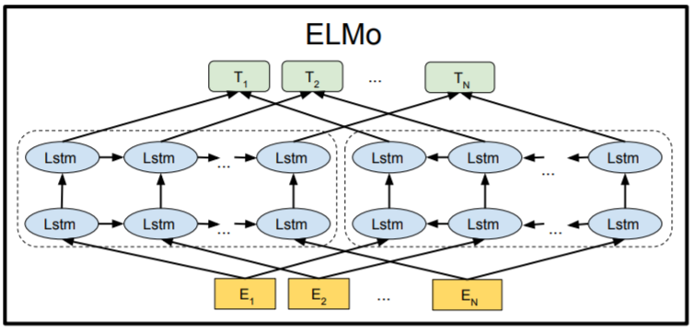
Introducing ELMo
Paper with deep insight: ”Deep contextualized word representations”, Peters et al, https://arxiv.org/pdf/1802.05365.pdf
Word vectors with context!
Bi-directional LSTM architecture, trained on 1bn+ word corpus on LM task
Final forward/backward vectors are concatenated
Model also returns output for intermediate layers
Image Source: ”BERT: Pre-training of Deep Bidirectional Transformers for Language Understanding”, Devlin et al, ,https://arxiv.org/pdf/1810.04805.pdf
Notes:
Talk through the architecture. Details of initial word-embeddings from running a CNN over character-level embeddings not crucial here.

Slide 56
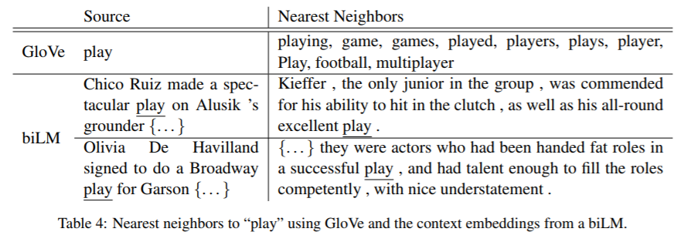
Some ELMo Results: GloVe vs Context Embeddings
Source: ”Deep contextualized word representations”, Peters et al, https://arxiv.org/pdf/1802.05365.pdf

Slide 57
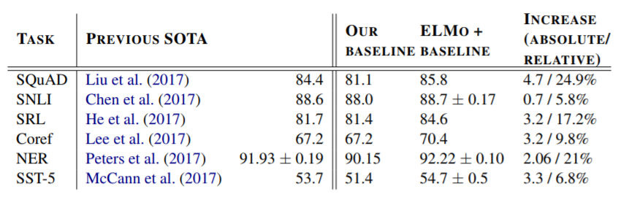
Comments
ELMo is available for download - full model is downloaded, not just the few embedding vectors!
Critical - Very useful for downstream NLP tasks!
Notes:
Language tasks use additional layers on top of ELMo.
Pre-trained models were fine-tuned for task
States from LSTM layers were actually mixed in for some models.
Source: ELMo paper: https://arxiv.org/pdf/1802.05365.pdf

Slide 58
Deep Averaging Networks
Output: Probability distribution over class labels
Questions:
What does this vector represent?
Are all tokens equally important? What would be nice if we could do it?
Sigmoid/Softmax
Affine
Nonlinearity
Averaging word vectors element-wise
(“bag of words”)
Affine
‘this’
‘is’
...
‘use’
Input:
“this is of great use”

Slide 59
Revisiting Averaging Networks
Output: Probability distribution over class labels
Questions:
With the Attention formalism… could we do this better?
What would we need? (Hidden hint: you’ll do that in your next assignment…)
Sigmoid/Softmax
Affine
Nonlinearity
Averaging word vectors element-wise
(“bag of words”)
Affine
q
‘this’
‘is’
...
‘use’
Input:
“this is of great use”

Slide 60
RNN and LSTM detailed matrix diagrams

Slide 61
RNN
X₁₁
X₁₂
X₁₁
H₁₁
X₁₂
H₁₂
H₀₁
H₀₂
X₂₁
X₂₂
X₂₁
H₂₁
X₂₂
H₂₂
Word embeddings
H₁₁
H₁₂
X₃₁
X₃₂
X₃₁
Q
this
delightful
movie
got
laughs
X₃₂
H₃₁
H₂₁
H₃₂
Q
H₂₂
RNN Layer
Output layer
W
x
W
softmax(z)
[x_{t}, h_{t-1}]
tanh(z)
x
x
h
q
Concatenate next word embed with last RNN output
+
+
=
=
z
z
b
b
Notes:
Pink = input (4 observations)
H1 = blue (4 hidden states but W and b are same size as they get re-used for each observation)
H2 = yellow (4 hidden states but W and b are same size as they get re-used for each observation)
Output = green (4 predictions)

Slide 62
LSTM (step 1)
LSTM Layer
Word embeddings (X)
multiply
c_{t’}
c_{t-1}
Forget gate
(last cell state)
W
(new cell state after step 1)
this
fun
movie
got
laughs
sigmoid(z)
x
[x_{t}, h_{t-1}]
+
=
z
b
to output layer
x
Input gate
…
Concatenate next word embed with last RNN output
Output gate
…
h
Notes:
Pink = input (4 observations)
H1 = blue (4 hidden states but W and b are same size as they get re-used for each observation)
H2 = yellow (4 hidden states but W and b are same size as they get re-used for each observation)
Output = green (4 predictions)

Slide 63
LSTM (step 2)
LSTM Layer
(new cell state after step 2)
c_{t}
Word embeddings (X)
c_{t-1}
Forget gate
…
(last cell state)
add
c_{t’}
this
fun
movie
got
laughs
Input gate
multiply
W₁
sigmoid(z)
x
W₂
Inputs
[x_{t}, h_{t-1}]
tanh(z)
to output layer
x
+
=
z
x
Concatenate next word embed with last RNN output
b
+
=
z
Output gate
…
h
b
Notes:
Pink = input (4 observations)
H1 = blue (4 hidden states but W and b are same size as they get re-used for each observation)
H2 = yellow (4 hidden states but W and b are same size as they get re-used for each observation)
Output = green (4 predictions)

Slide 64
LSTM (step 3)
LSTM Layer
Word embeddings (X)
c_{t-1}
Forget gate
…
(last cell state)
this
fun
movie
got
laughs
Input gate
…
tanh(c_{t})
c_{t}
Output gate
W
sigmoid(z)
to output layer
x
[x_{t}, h_{t-1}]
x
multiply
Concatenate next word embed with last RNN output
+
=
z
h
b
Notes:
Pink = input (4 observations)
H1 = blue (4 hidden states but W and b are same size as they get re-used for each observation)
H2 = yellow (4 hidden states but W and b are same size as they get re-used for each observation)
Output = green (4 predictions)

Slide 65
A few more LSTM resources

Slide 66
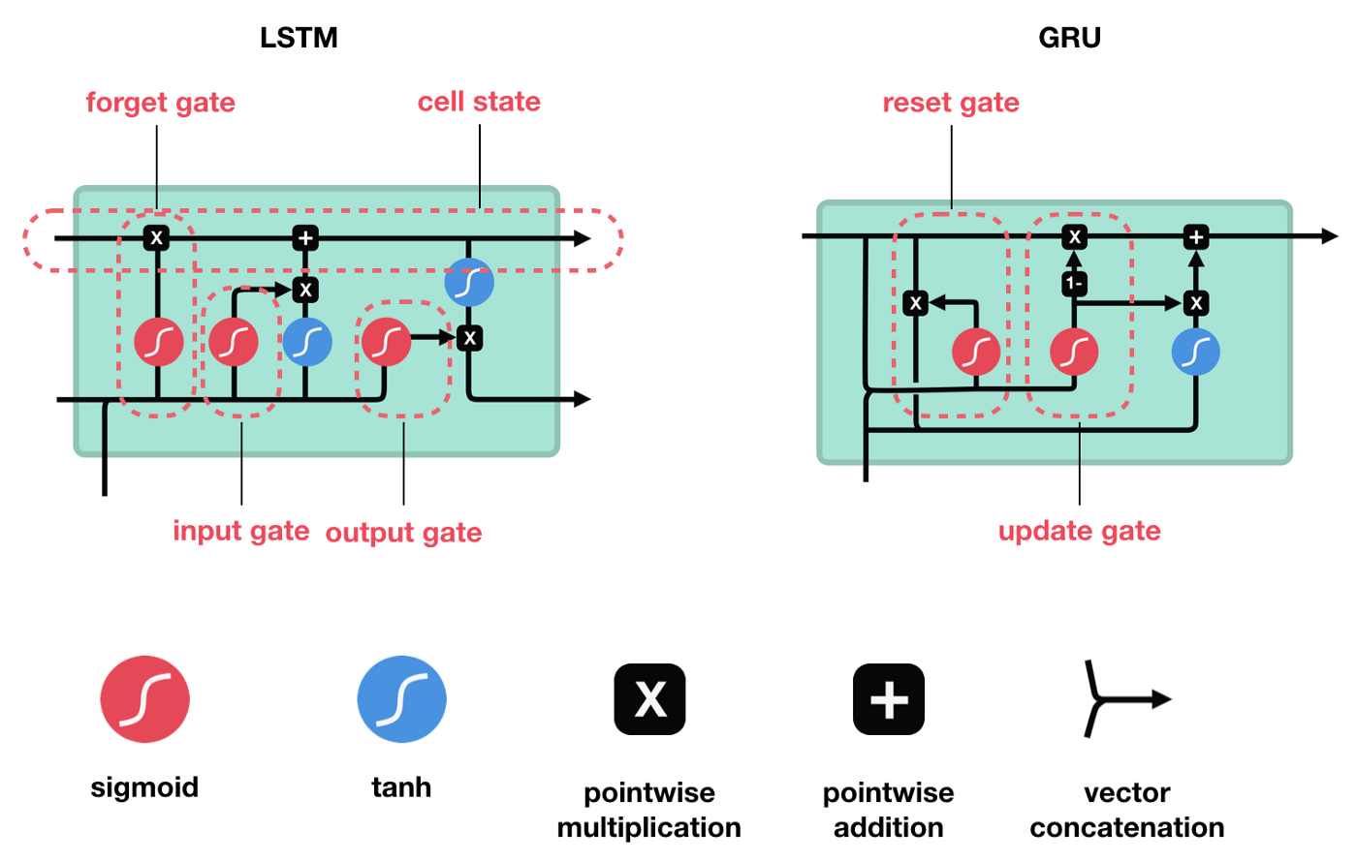
LSTM Visual Walk-Through
This blog post has an excellent visual walk-through of the LSTM architecture, with animated gifs of each step.
Source: Illustrated Guide to LSTM’s and GRU’s: A step by step explanation

Slide 67
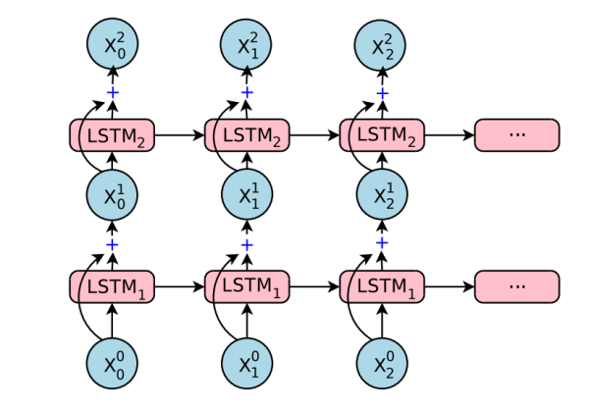
Stacked LSTMs
The output of the first LSTM is a sequence of more contextualized word embeddings.
That becomes the input embedding sequence for the second LSTM.
Source: Understanding the new Google Translate (2017)

Slide 68
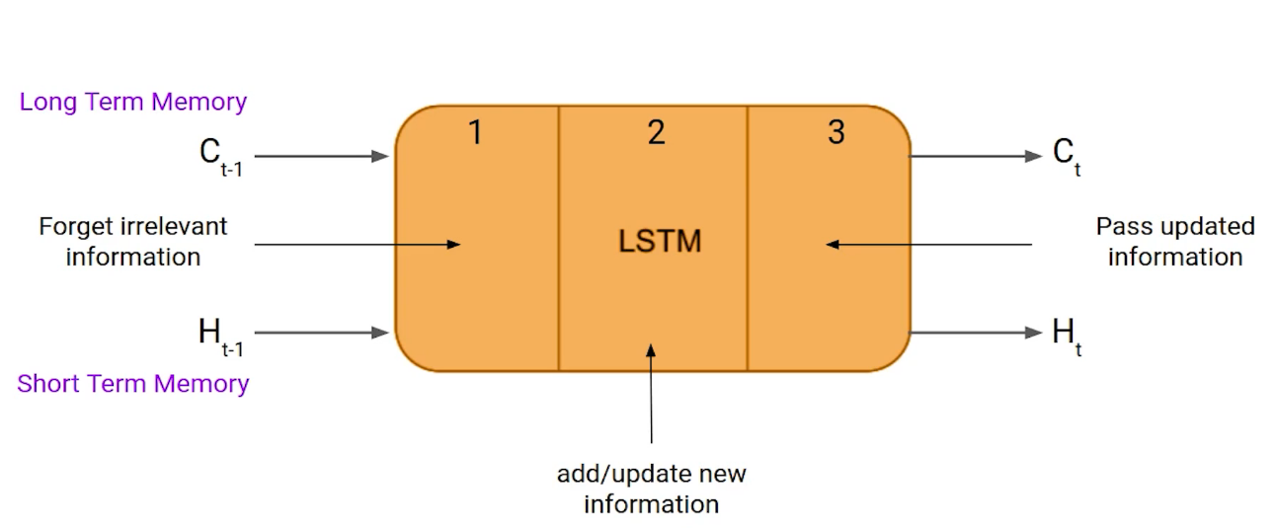
Simple Explanation
This blog post has a simpler explanation of LSTMs, with example:
“Bob is a nice person. Dan on the other hand is evil.” (When do we forget memory about Bob?)
Source: Introduction to Long Short Term Memory (LSTM)

Slide 69
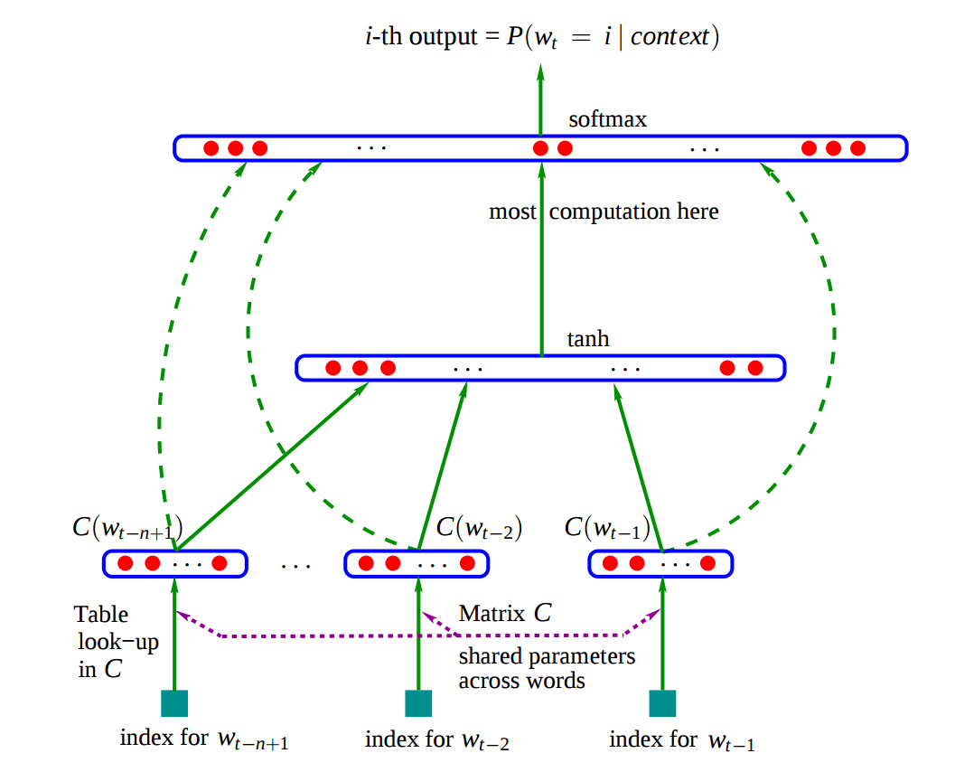
Language Model: Older Approaches
Build LM successively from prior sequences: Two approaches with limitations:
N-grams/Counting: window size, sparsity, ...
Simple Neural Language Model:
window size still an issue
What are the limitations? Can we do better?
Source: Neural Probabilistic Language Model (NPLM) (Bengio et al. 2003)
Notes:
Limitations: blind to everything outside of the window
How to do better: RNNs & Attention based models

Slide 70
Convolutional Neural Networks
Input:
256 x 256 x 3
Questions:
How many filters in convolutional layer?
If kernel size is 4, what are the dimensions of the filters?
Was padding used?
What is z in the pooling layer?
‘What’ do filters learn?
Pooling Layer Output:
64 x 64 x z
Convolutional Layer
Pooling Layer
Convolutional Layer Output:
128 x 128 x 100
Notes:
And Stride 2
OUT = (IN - F +2*P)/S +1
128 = (256 - 4 +2*P) /S +1

